Slide 1

CAPSTONE PROJECT
PLANT LEAF DISEASE IDENTIFICATION AND CLASSIFICATION USING OPENCV AND MACHINE LEARNING
DSA0201- COMPUTER VISION WITH OPENCV
PRESENTED BY:
B. HEMANTH KUMAR (192324238)
P. NANDIVARDHAN (192324270)
K V KARTHIKEYA (192324183)
Guided By:
Dr. M. MAYURANATHAN

Slide 2


INTRODUCTION
Plant Leaf Disease Identification and Classification using OpenCV and Machine Learning is a computer vision-based approach that helps automate the detection and classification of diseases from plant leaf images.
In this system, OpenCV is used for image processing tasks such as image acquisition, resizing, noise removal, color conversion, segmentation, and feature extraction.
Machine learning algorithms are then applied to analyze the extracted features and classify the leaf into healthy or diseased categories.
Plant diseases are a major challenge in agriculture because they can reduce crop quality, productivity, and economic value.
Traditionally, plant diseases are identified manually by farmers or agricultural experts through visual inspection, which can be time-consuming, subjective, and difficult when large numbers of plants need to be monitored.

Slide 3
PROBLEM STATEMENT
Plant diseases significantly affect agricultural productivity and crop quality.
Early identification of diseases is important to prevent their spread and reduce crop losses.
This process can be time-consuming, subjective, and difficult to perform accurately when a large number of plants need to be examined.
Therefore, there is a need for an automated system that can identify and classify plant leaf diseases accurately and efficiently from leaf images.
The proposed Plant Leaf Disease Identification and Classification using OpenCV and Machine Learning system aims to process leaf images using OpenCV techniques such as image preprocessing, segmentation, and feature extraction, and then apply machine learning algorithms to classify the leaves into healthy or different disease categories.

Slide 4
OBJECTIVES
To develop an automated system for identifying and classifying plant leaf diseases using digital images.
To preprocess plant leaf images using OpenCV techniques such as resizing, noise removal, color conversion, and image enhancement.
To segment the diseased regions of plant leaves and identify important visual characteristics.
To extract relevant features such as color, texture, and shape from the processed leaf images.
To apply machine learning algorithms for accurate classification of healthy and diseased plant leaves.
To evaluate the performance of the developed model using suitable metrics such as accuracy, precision, recall, and F1-score.
To reduce manual inspection time and effort required for identifying plant diseases.

Slide 5
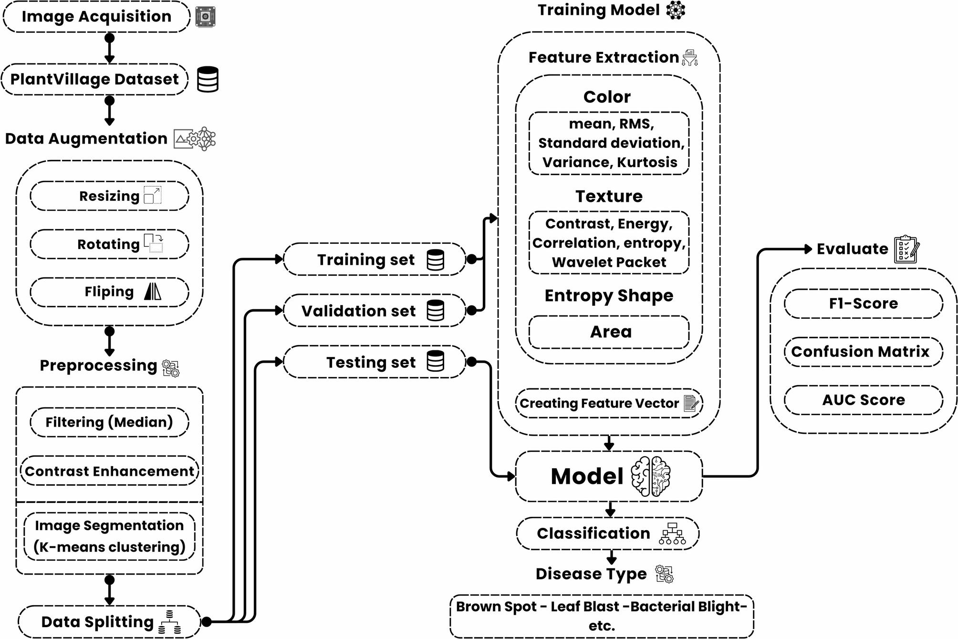
LITERATURE REVIEW

Slide 6
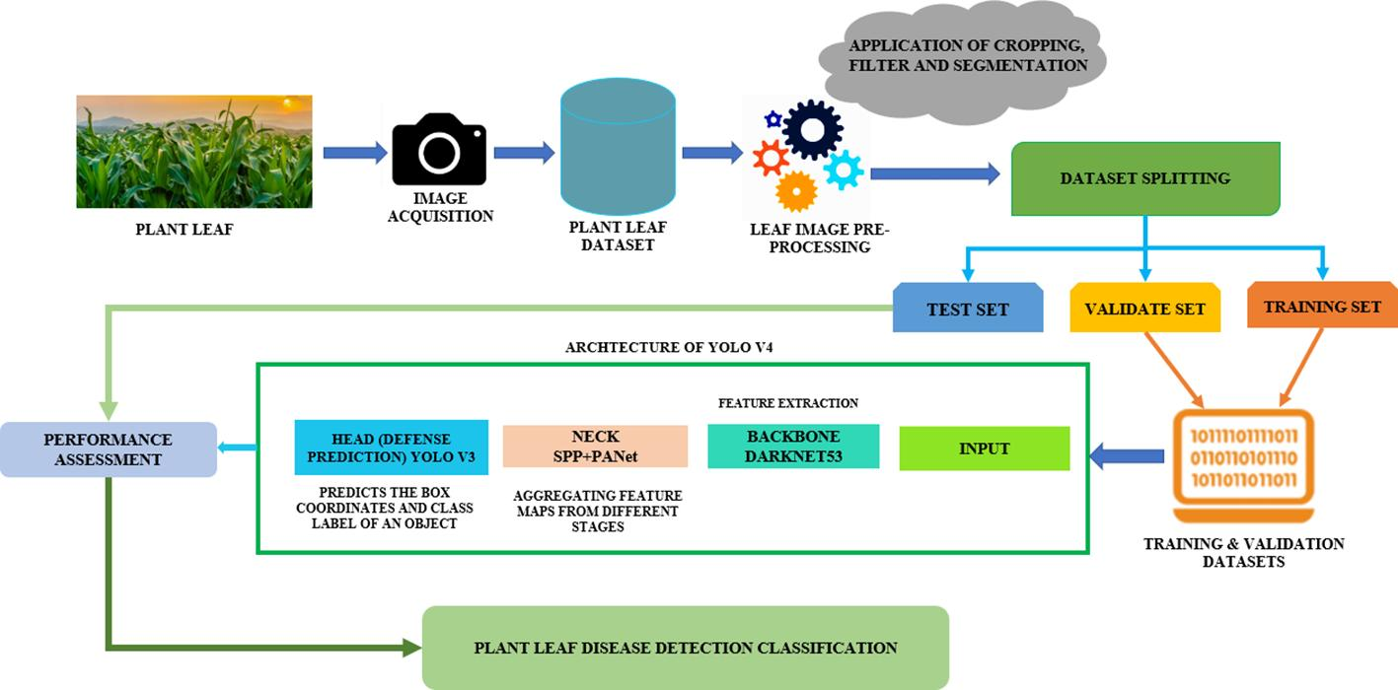
SYSTEM ARCHITECTURE

Slide 7
MODULE 1: IMAGE ACQUISITION AND PREPROCESSING
Collect plant leaf images from a reliable dataset or capture them using a digital camera or mobile camera under suitable lighting conditions.
Load the collected leaf images into the system using OpenCV for further processing and analysis.
Resize all images to a fixed and consistent resolution so that they can be processed efficiently.
Remove unwanted noise, blur, and small artifacts using appropriate image filtering techniques.
Convert the images from RGB into suitable color spaces such as HSV or grayscale to improve the identification of disease-related features.
Enhance image quality by adjusting brightness, contrast, and other image properties.

Slide 8
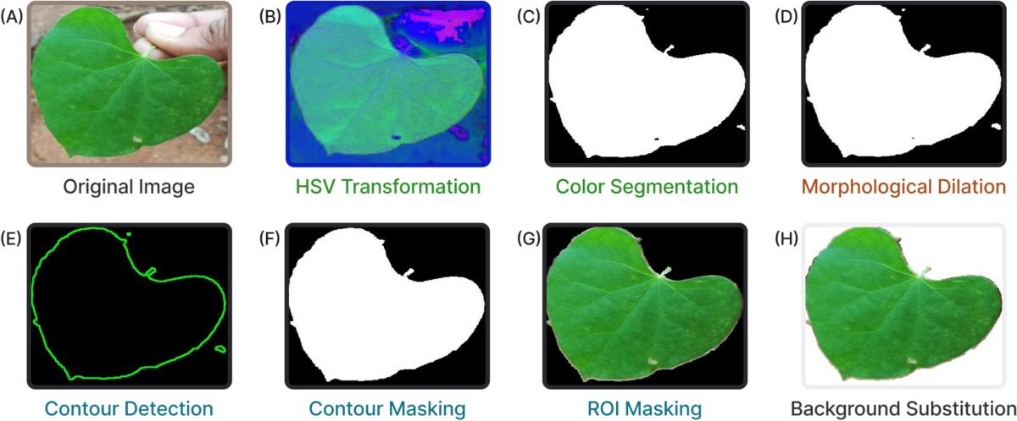
MODULE 1: OUTPUT

Slide 9
MODULE 2: FEATURE EXTRACTION AND DISEASE DETECTION
Extract important characteristics from the preprocessed plant leaf images for identifying disease patterns.
Analyze the color features of the leaf to identify abnormal color changes associated with different diseases.
Extract texture features to detect spots, patches, lesions, and other surface abnormalities present on the leaf.
Analyze the shape and structure of the leaf to identify changes caused by disease infection.
Segment the leaf image to separate healthy portions from potentially infected or damaged regions.
Identify important disease-related regions by analyzing differences in color, texture, and appearance.

Slide 10
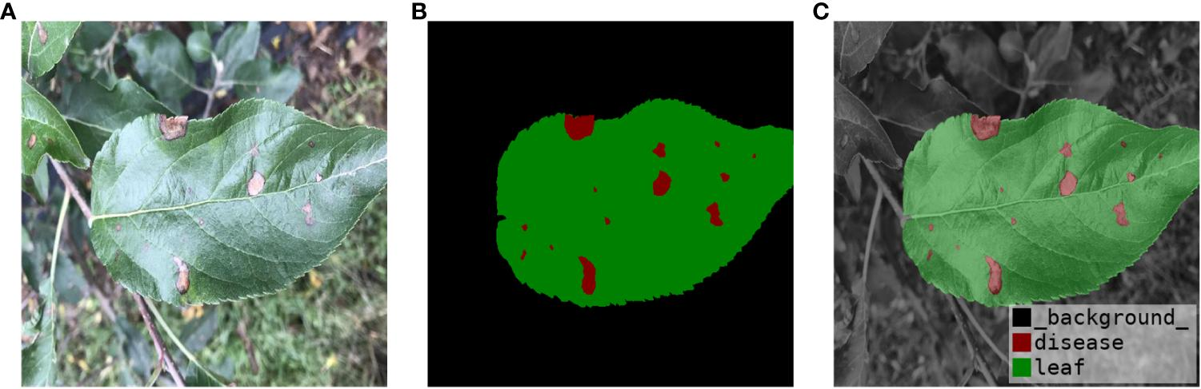
MODULE 2: OUTPUT

Slide 11
MODULE 3–MACHINE LEARNING-BASED DISEASE CLASSIFICATION AND PREDICTION
Use the extracted color, texture, and shape features as input for the machine learning classification model.
Train the machine learning model using labeled plant leaf images containing healthy and diseased samples.
Learn the patterns and characteristics associated with different types of plant leaf diseases.
Test the trained model using unseen leaf images to evaluate its classification performance.
Classify the input leaf into the appropriate category based on the learned features.
Identify whether the plant leaf is healthy or diseased.
If the leaf is diseased, determine the specific disease category based on the trained dataset.
Calculate performance measures such as accuracy, precision, recall, and F1-score to evaluate the model.

Slide 12
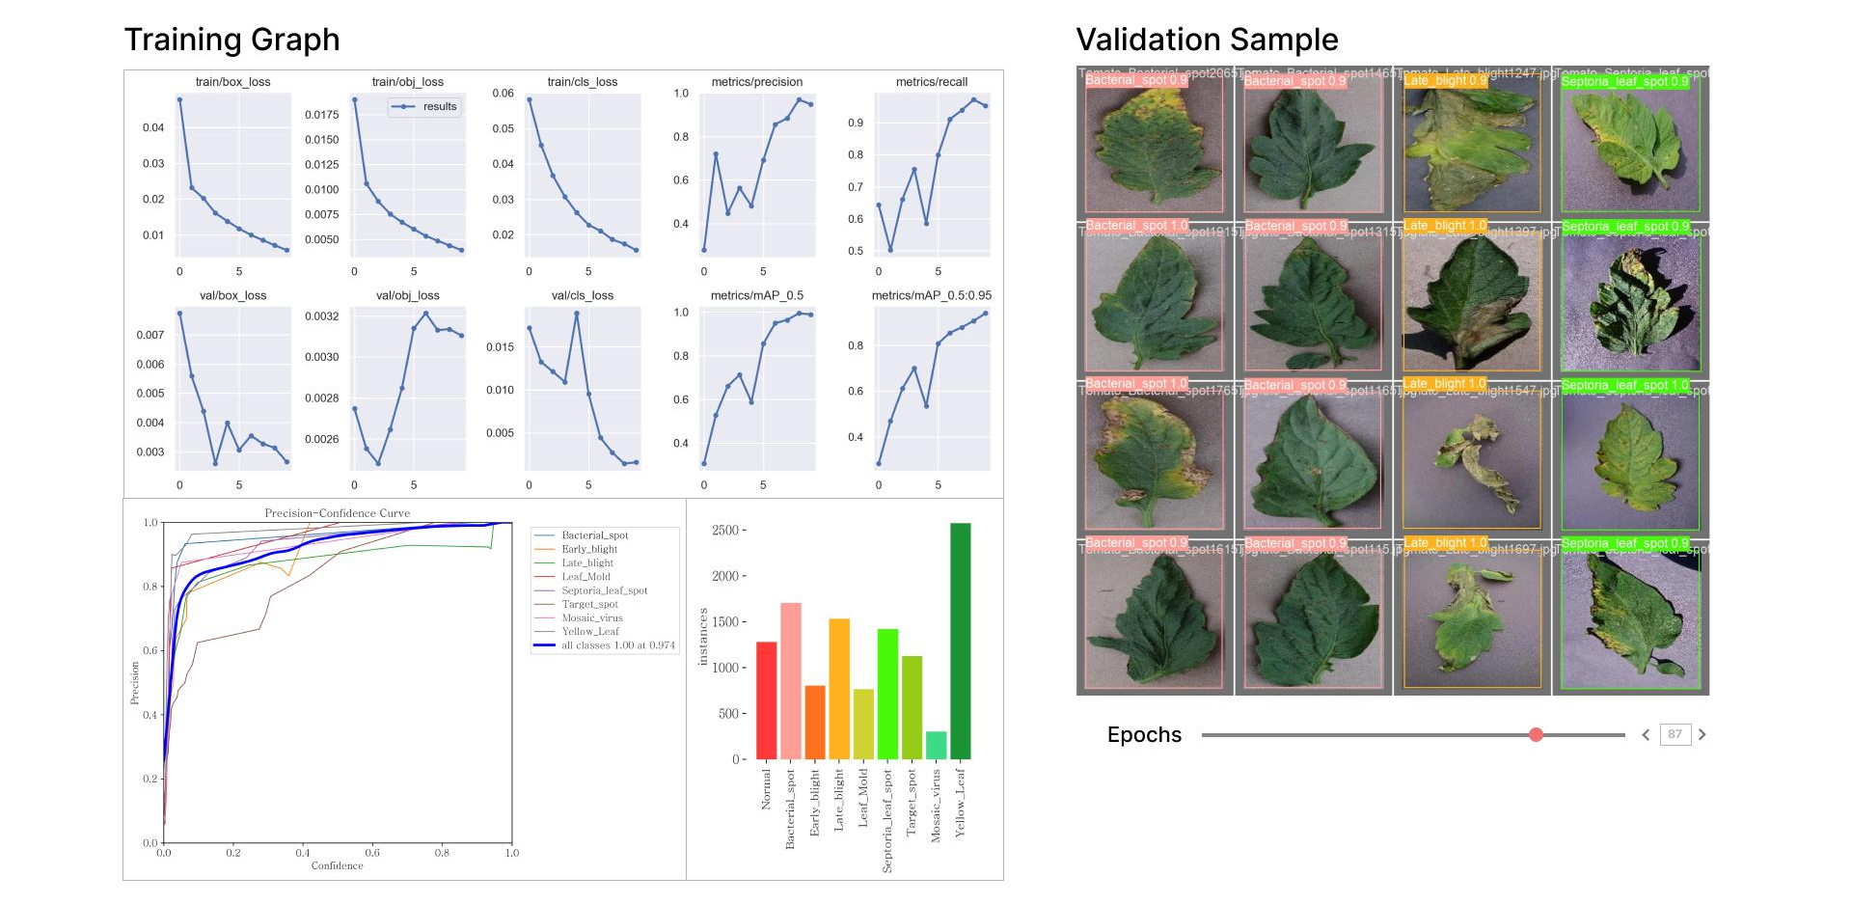
RESULTS AND INSIGHTS
plant_leaf_disease_website.html

Slide 13
FUTURE WORK
Improve the accuracy of disease classification by using advanced machine learning and deep learning algorithms.
Develop a Convolutional Neural Network (CNN) model to automatically learn important features from plant leaf images.
Expand the dataset by collecting more images of different crops, diseases, leaf conditions, and environmental backgrounds.
Develop a real-time disease detection system that can analyze leaf images directly through a mobile or web application.
Integrate the system with cameras or drones for large-scale monitoring of agricultural fields.
Add more plant species and disease categories to make the system applicable to a wider range of crops.

Slide 14
CONCLUSION
The system provides an automated approach for identifying and classifying plant leaf diseases from images.
OpenCV is effectively used for image preprocessing, enhancement, segmentation, and feature extraction.
Important features such as color, texture, and shape are extracted from plant leaf images.
Machine learning techniques are used to classify leaves into healthy and diseased categories.
The system reduces the time and effort required for manual disease identification.
Automated classification provides faster and more consistent results compared with traditional visual inspection.

Slide 15
THANK YOU

